Slide 1

CLIQUE – Experience Luxury At Convenience

Slide 2










Truevibez – Key Programs
Hospitality Governance: This is a hospitality governance service which will host a variety of sub-programs to assist restaurant owners run their businesses more effectively and bring more value into their service by introducing staff training, incentive schemes and customer conversion.
Broadcast & Livestreaming: This is a premium media & entertainment service for our restaurant partners, which would bring live performances from renowned artists directly to our restaurant’s customers for enhanced hospitality experience.
Dine Now, Pay Later: Project named as Clique, is premium service offered to our finest customers & business partners, to mutually benefit through means of microfinancing services. It will be based on a service aggregation model in tie up with financial institutions and hospitality associations, across geographies.

Slide 3



Clique – The Opportunity under Truevibez Umbrella
Clique is premium service offered to our finest customers & business partners, to mutually benefit through means of microfinancing services.
Dine Now, Pay Later
For customer expecting an event to visit restaurant but without available liquid funding, Clique will open up a line of credit in handshake with a lender (NBFC). The customer can request this restaurant-focused credit line and once approved, use it at any partner restaurant.
Merchant Employee Lending
Restaurant staff currently face many challenges in requesting loans from banks and NBFCs however from recommendation of a partner merchants, a lo-medium size credit pool will be made available to them with flexible repayment options.
With microfinance market anticipated to grow with CAGR of 40% through 2025, NBFC-MFIs will be its greatest beneficiaries. In F&B segment, unbanked microlending has only reached 12-15% of the prospective market.

Slide 4
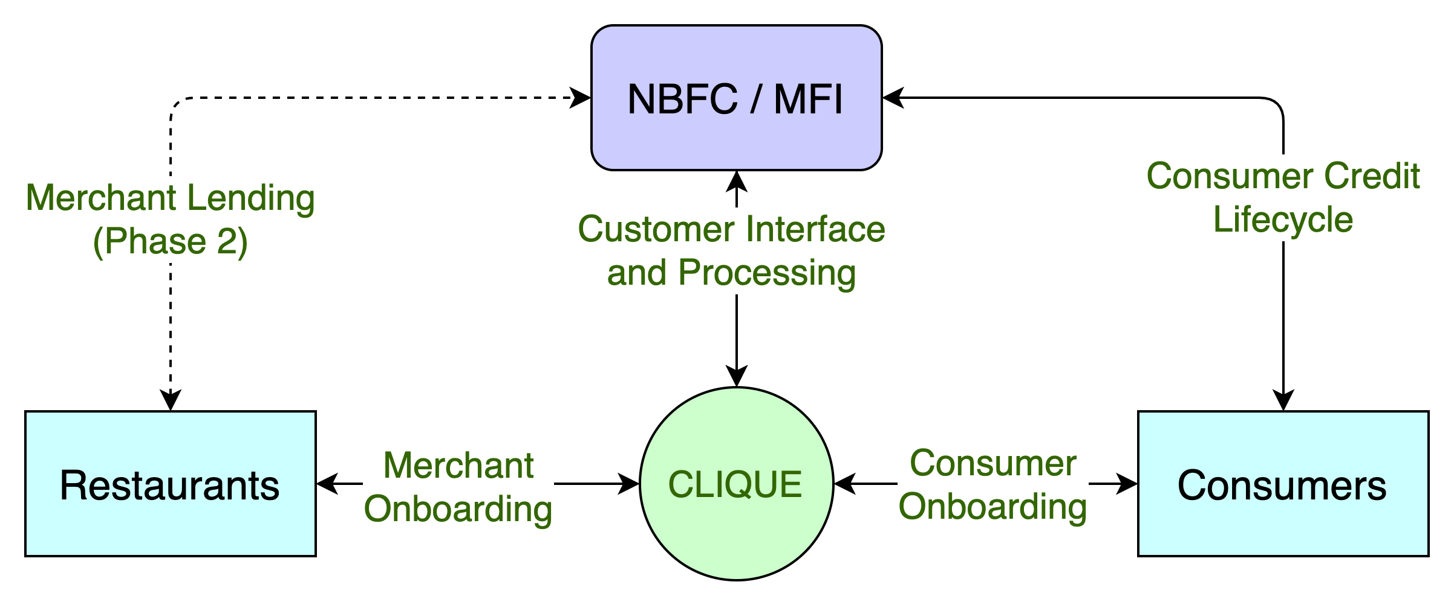
Clique – High Level System Flow
CASE STUDIES
Zomato, in partnership with InCred, to lend Rs 1L to 50k restaurants, developing loan book of 500CR
PAYO (Australia) – Launched ENPL service in July-21 & already has 500+ restaurant partners

Slide 5
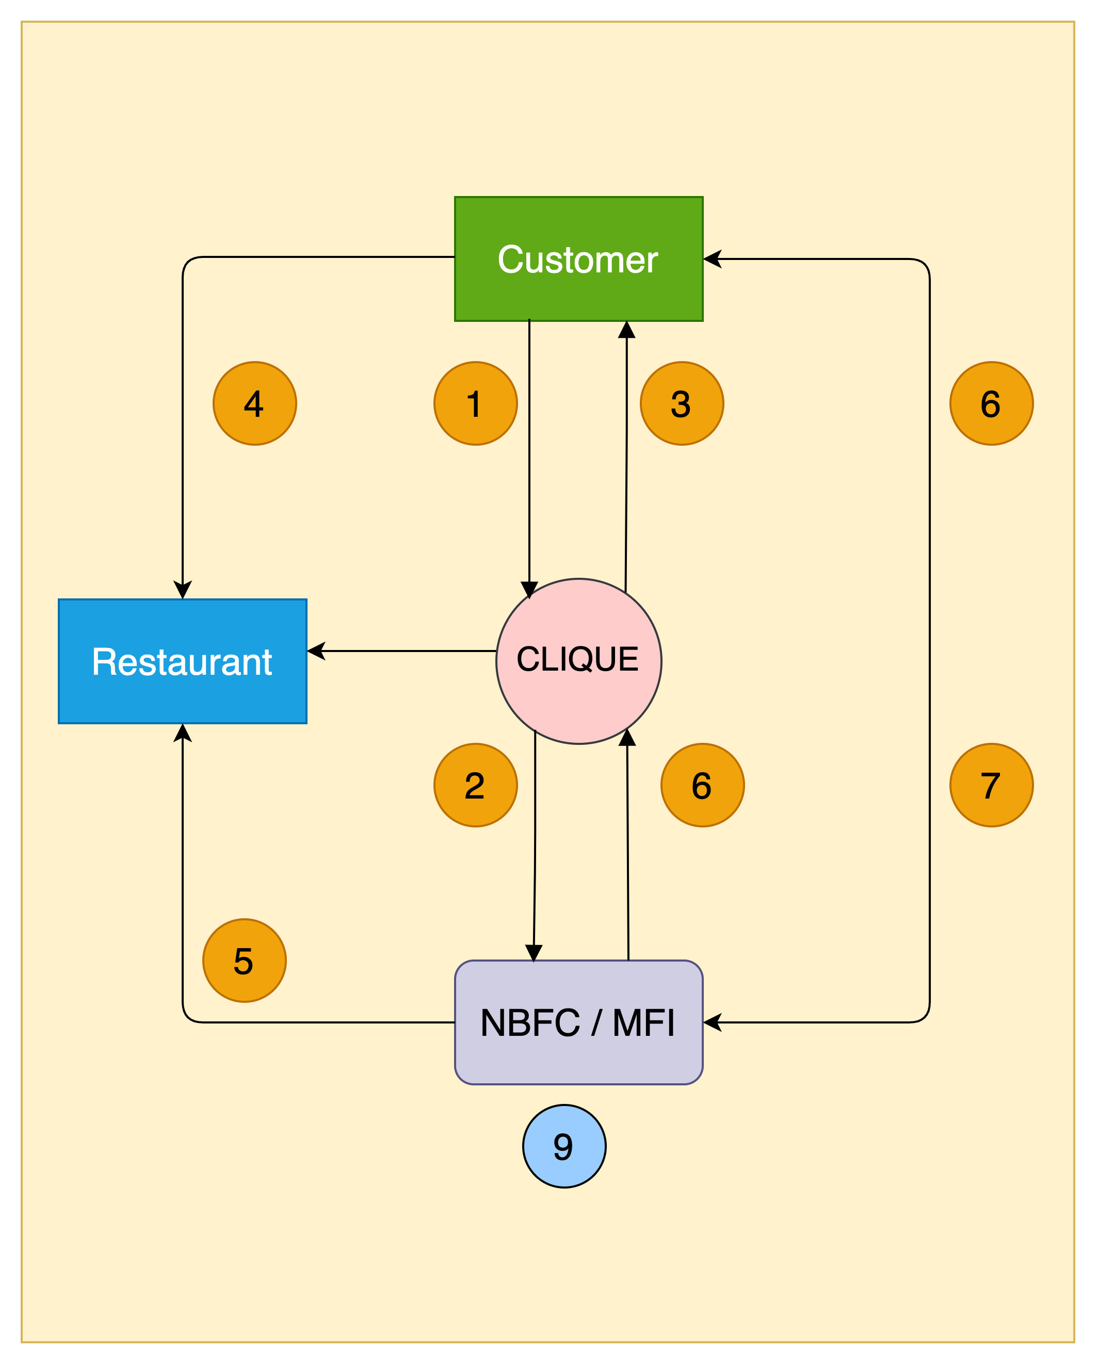
Clique – High Level Transaction Process Flow
1. Customer walks into a restaurant & applies for the wallet credit through Clique App
2. Clique receives customer application & send it to the lender for underwriting & respond with approval or rejection
3. Customer app wallet is credited with approved funds & signs NACH mandate
4. Customer utilises the wallet credit at the restaurant e.g., Rs 5000
5. Lender pays the merchant (less the operational charges) based on merchant's billing cycle e.g., Rs 4000
6. Lender pay the commission to Clique e.g., Rs 800 based on payment reconciliation, on agreed frequency
7. Customer pays lender later based on agreed T&C,
including interests, delay charges etc.
8. Once paid, even if partially, lender updates Clique to reset
customer’s wallet for calculated funds for further utilisation
9. Lender keeps the balance i.e., Rs 200, for their services

Slide 6
Clique – Customer Onboarding Journey
02
Customer reviews standees, flyers, tent cards and informed by staff about Clique
03
Customer downloads Clique app and completes KYC application
01
Customer walks into
a restaurant
Clique routes the application to lender
06
Lender sends a confirmation back to Clique
04
05
Lender underwrites the customer
07
Clique updates customer app and reflects the wallet credits
08
Customer enjoys the F&B services
09
Customer pays through clique credit & returns home

Slide 7
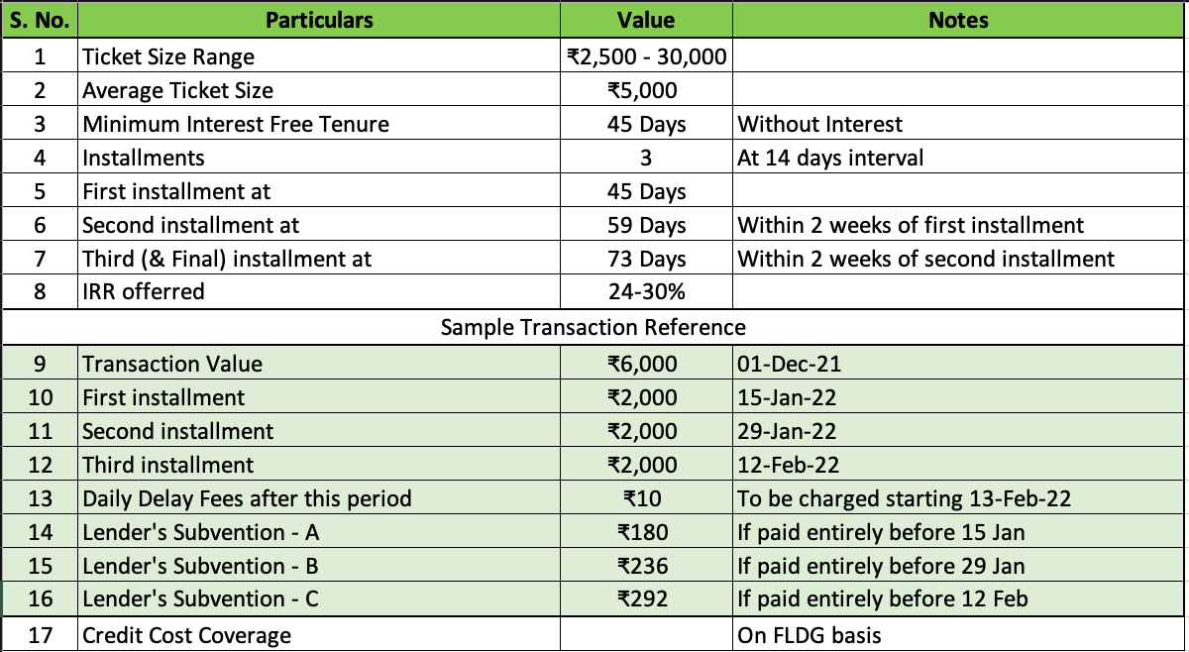
Commercial Summary

Slide 8
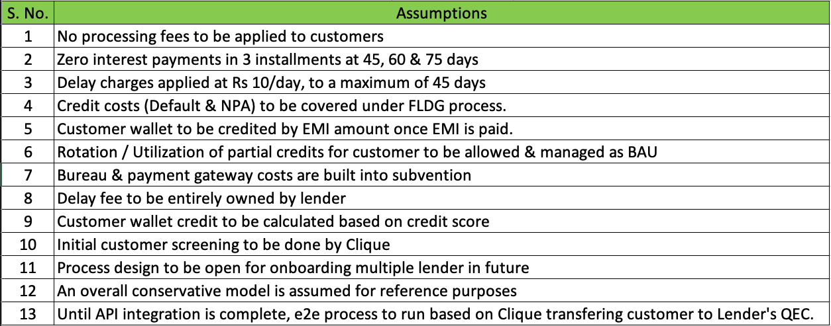
Key Commercial Assumptions

Slide 9







PAYO (Australia) – A case study
About PAYO
PAYO is an Australian company who have launched the world’s first Eat Now, Pay Later service in July 2021.
The are backed by an existing lender with substantial customer base in the operational regions.
Being the World’s first ENPL app, they have favorably placed themselves as market disrupters, driving investor’s interest & confidence.
Within 3 months of launch, 700+ merchants in 4 cities & growing at the pace of 200 merchants every month
All payments are divided across 4 interest free EMIs, with only a quarter of payment to be made upfront.
Top performing 50 restaurants have received thousands of transactions with recorded order value increase of 60%
Diners can discover restaurants, filter by preferences, call restaurant, book table and receive range of offers & deals.
Both restaurants & customers are incentivized for referring more paying users to the platform
All payments are via PAYO app via QR codes with options for customer to recommend for PAYO business
Instant approval & discreet process has given PAYO an edge over other modes of payments, eliminating need to carry wallets

Slide 10
Project Plan – 6 Phased
Phase 06
Q3 2024
Expand in existing 7 Cities & explore additional scope
Target 2400 Restaurants & 3 Lacs Customers per city
3600 FL3
36Lacs FL4
3000 FL3
30 Lacs FL4
Phase 05
Q1 2024
Expand in existing 7 Cities & explore additional scope
Target 2000 Restaurants & 1.5 Lacs Customers per city
Phase 04
Q3 2023
Expand in existing 7 Cities & explore additional scope
Target 1600 Restaurants & 75K Customers per city
2400 FL3
24 Lacs FL4
1800 FL3
18 Lacs FL4
Phase 03
Q1 2023
Expand in existing 7 Cities & explore additional scope
Target 1200 Restaurants & 25K Customers per city
Phase 02
Q3 2022
Expand in existing 7 Cities & explore additional scope
Target 800 Restaurants & 10k Customers per city
1200 FL3
12Lacs FL4
Phase 01
Q1 2022
Launch in 7 Cities
Target 400 Restaurants & 1200 Customers per city
Company Registration : July 2020 - Complete
MVP PoC : Dec 2021
Foundation Period : Q1 2022
Launch : Q1 2022

Slide 11
Our Team
Promoters
Rajesh Karandikar
Alok Sambuddha
Board Of Directors
Suhas Gokhale : Managing Director, COSMOS Bank, Pune
Rahul Renavikar :Managing Director, Acuris Advisors (GST & Government Policies) – Ex. Big 4 & Tata Motors
Shrikant Chatur; Governance Consultant (ex. VP Commercial - Cummins)
Chetan Oswal : Accounts & Legal Counsel
Corporate Partners
NPCI (Nth Reward), Pune Mirror (TOI)
Krios Info Solutions, Sazinga Digital
Staratacache (SCALA) – Broadcasting & Livestreaming Infrastructure Partner

Slide 12






Question & Answers

